Slide 1
Malicious Logic
Unit 7
Abhishek Dewan Lecturer Cryptography, Trinity Int’l College

Slide 2
Is everything virus?

Slide 3
Malicious code: The general term
Malicious code refers to a broad category of software threats to our network and systems.
Also known as Malware.
exploit vulnerabilities in computer systems.
Any code which modifies or destroys
data, steals data , allows unauthorized access, exploits or damage a system, and does something that user did not intend to do, is called malicious code.

Slide 4
A computer program is a sequence of instructions that are caused to achieve a desired functionality.
the program is termed malicious when their sequences of instructions are used to intentionally cause adverse affects to the system.
Note: A ‘bug’ is not a malicious code: it’s just a code with some errors which can be fixed. Usually, Beta version softwares contain bugs.

Slide 5
Malicious Program
Needs host program Independent Logic Trojan Virus Worms Bomb Horse
*can replicate itself

Slide 6
Types of malicious code
Virus
Trojan Horse
Logic Bomb
Worm

Slide 7
Virus
Vital Information Resource Under Seize
A virus contains malicious code that attaches itself to an application.
When the infected application is executed, the virus is launched and will attempt to spread to other computers and files in the computer.
A virus may not cause immediate damage as it needs time to replicate in order to infect other computers.

Slide 8
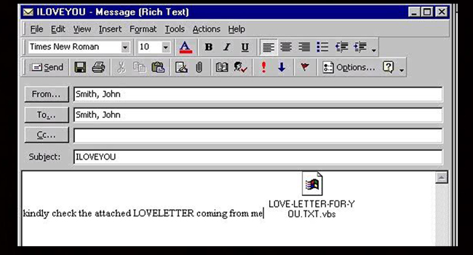
World’s some top virus
I love you virus

Slide 9
ILOVEYOU, sometimes referred to as Love Bug or Love Letter for you, is a computer worm that infected over ten million Windows personal computers on and after 5 May 2000 local time in the Philippines
When it started spreading as an email message with the subject line "ILOVEYOU" and the attachment "LOVE-LETTER-FOR-YOU.txt.vbs".

Slide 10
Opening the attachment activates the Visual Basic script.
The worm inflicts damage on the local machine, overwriting random types of files (including Office files, image files, and audio files; however after overwriting MP3 files the virus hides the file), and sends a copy of itself to all addresses in the Windows Address Book used by Microsoft Outlook.

Slide 11
The sweet-named virus had terrified the world in 2000.
It was detected in Philippines and soon captured 10% of the world's web-connected computers.
The damage was worth over five billion dollars.

Slide 12
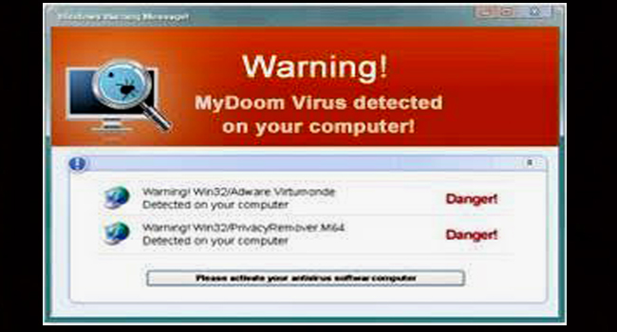
My Doom:

Slide 13
On January 26, 2004, this virus spread all over the Internet via emails with random addresses and subject lines.
My Doom or Novarg is said to be the most dangerous virus ever to occur.
It infected two million computers and triggered a huge denial of service attack.
The damage caused by My Doom was estimated at over 38 billion dollars. (Isn’t that huge?)

Slide 14
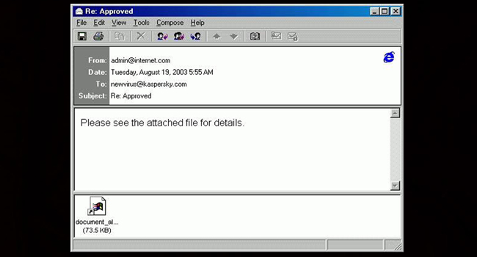
Sobig F

Slide 15
This virus would fool the user by trying to convince them that the spam mail they received is from an authentic source.
The Sobig F worm replicated over one million copies of itself within 24 hours of its launch in 2003.
The virus caused a damage of 3 to 4 billion dollars and infected over 2 million systems across the world.

Slide 16
Self-study on some most recent popular viruses around the world.

Slide 17
Probable effects of virus:
deletion of critical system files
random reboots of your computer
can corrupt hard drives
can corrupt the file
hiding the file
making duplicate copies of files.

Slide 18
Delivery of virus:
Viruses are delivered to systems in a variety of ways.
Email is the most common method for spreading viruses.
For example, spammers will email viruses as attachments and will entice users to download and open the attachment, which in turn will execute the virus.
Users can also transmit viruses by using infected USB flash drives or infected applications.

Slide 19
Infection algorithm of Virus
beginvirus:
if spread-condition then begin
for some set of target files do begin
if target is not infected then begin
determine where to place virus instructions
copy instructions from beginvirus to endvirus into target
alter target to execute added instructions
end;
end;
end;
perform some action(s)
goto beginning of infected program
endvirus:

Slide 20
Types of Virus:
Boot Sector Virus
Modify boot sector files causing unexpected reboots or preventing from booting.
Example: Disk Killer, Stoned
Parasitic Virus
Attaches to a file and activates when that file is executed.
Example: Jerusalem, Datacrime

Slide 21
Polymorphic Virus
Changes virus signature every time it replicates. Mutate like a biological virus.
Example: Cascade, Phoenix
Stealth Virus
Hard to detect. Tries to skip from Antivirus applications,
usually Quick Scan.
Example: Frodo, Whale

Slide 22
Trojan Horse
Trojan horses trick users by posing as legitimate applications.
program with an overt (documented or known) effect and a covert (undocumented or unexpected) effect.
a useful program or command containing hidden code that, when invoked, performs some unwanted or harmful actions

Slide 23
For example, a Trojan horse may appear to be a game or a screensaver or a game or a mobile application or a utility program or a textual hyperlink
Trojan horse is released once the user executes the program.
Once activated, Trojans can steal your sensitive data or gain backdoor access to your system but the effect may vary.

Slide 24
Probable effects of Trojan Horse:
Deleting data
Blocking data
Modifying data
Copying data
Disrupting the performance of computers or computer networks
Note: Trojans are not able to self replicate like virus.

Slide 25
Example of Trojan Horse
A program named "waterfalls.scr" serves as a simple example of a Trojan horse. The author claims it is a free waterfall screensaver. When run, it instead unloads hidden programs, commands, scripts, or any number of commands without the user's knowledge or consent.

Slide 26
Worms
Unlike viruses and Trojan horses, worms do not need to be executed.
Worms reside within memory and can travel throughout a network without depending on an infected computer application or interaction.
Worms replicate themselves exponentially and can literally crash networks by consuming excessive bandwidth.

Slide 27
Types of Worms
Electronic mail facility: A worm mails a copy of itself to other system.
Remote execution capability: A worm executes a copy of itself on another system.
Remote login capability: A worm logs onto a remote system as a user and then uses commands to copy itself from one system to the other.

Slide 28
Logic Bomb
A logic bomb is malicious code embedded within an application that executes based on certain events.
The logic bomb lies dormant until that event occurs.
The event may be when a specific date is reached.
Note: Time Bomb is a variant of Logic Bomb. It executes when a certain date/time is reached. Like Christmas, New Year.

Slide 29
Example of Logic Bomb
For example, cyber-criminals may use spyware to covertly install a keylogger on your computer.
The keylogger can capture your keystrokes, such as usernames and passwords.
The logic bomb is designed to wait until you visit a website that requires you to log in with your credentials, such as a banking site or social network.
Consequently, this will trigger the logic bomb to execute the keylogger and capture your credentials and send them to a remote attacker.

Slide 30
Vulnerability to malicious code
Homogeneity
when all computer in the network run same OS.
If one of them is infected, then others can be infected soon.
Defects
systems containing errors which may be exploited by malware.
Over-privileged users
providing over-privilege to the users, gives extra permission which may lead to attack.
Example: Rooting andriod devices and jailbreaking ios devices
Over-privileged codes
providing over-privilege to the code, gives extra permission which may lead to attack.

Slide 31
Cryptanalytic Attacks
Cryptanalysis is the study of methods for obtaining the meaning of encrypted information, without access to the secret information which is normally required to do so. Typically, this involves finding a secret
key.

Slide 32
Man-in-the-middle attack
In this "man-in-the-middle attack“, the attacker is able to position himself to intercept the key exchange between two parties.
He performs his own key exchange with each.
Users will be unknown of the attack and message interception.
The attacker uses his key to both encrypt and decrypt the message in the communication.

Slide 33
Brute force attack
A brute-force attack involves trying every possible key until an intelligible translation of the cipher text into plain text is obtained.
On average, half of all possible keys must be tried to achieve success.
This can involve significant costs related to the amount of processing required to try millions of keys.
Multiple computers can be assigned to the task in parallel.

Slide 34
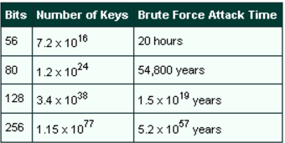
This table shows the times required for a brute force attack on various key lengths.

Slide 35
Denial of Service Attack (DoS)
a denial-of-service attack (DoS attack) is a cyber-attack in which the perpetrator seeks to make a machine or network resource unavailable to its intended users by temporarily or indefinitely of a host connected to the Internet.
Denial of service is typically accomplished by flooding the targeted machine or resource with superfluous requests in an attempt to overload systems and prevent some or all legitimate requests from being fulfilled.

Slide 36
Types of DoS attack:
Flooding attacks flooding is the more common form of DoS attack. It occurs when the attacker overwhelms the system by large amount of traffic that the server is unable to handle.

Slide 37
ICMP flood - also known as ping flood. - Type of attack that sends packets of information to every computer in a targeted network.
SYN flood
-

Slide 38
SYN flood
In a SYN flood scenario, the requester sends multiple SYN requests, but either does not respond to the host’s SYN-ACK response.
the host system continues to wait for acknowledgement for each of the requests, binding resources until no new connections can be made, and ultimately resulting in denial of service.

Slide 39
Distributed Denial of Service Attack(DDoS)
- DDoS attack is an attack where multiple compromised systems simultaneously attack a single system.

Slide 40
Intruder
- Intruder is a person who attempts to gain unauthorized access to a system, to damage that system or to disturb data on that system.

Slide 41
Examples of intrusion:
Cracking of passwords
Copying a database contents
Viewing sensitive data
Running a packet sniffer
Gaining unauthorized network access
Using unattended workstation without permission

Slide 42
Three classes of intruders:
Masquerader
unauthorized user who penetrates a system exploiting a legitimate user’s account.
Misfeasor
legitimate user who makes unauthorized accesses or misuses his privileges.
Clandestine user
- seizes supervisory control to evade auditing and access controls.

Slide 43
Intrusion Detection System (IDS)
An Intrusion Detection System (IDS) is a system that monitors network traffic for suspicious activity and issues alerts when such activity is discovered.
It is a software application that scans a network or a system for harmful activity or policy breaching.
Any malicious venture or violation is normally reported either to an administrator or collected centrally using a security information and event management (SIEM) system.

Slide 44
Classification of Intrusion Detection System:
Network Intrusion Detection System (NIDS)
NIDS are set up at a planned point within the network to examine traffic from all devices on the network.
It performs an observation of passing traffic on the entire subnet and matches the traffic that is passed on the subnets to the collection of known attacks.
Once an attack is identified or abnormal behavior is observed, the alert can be sent to the administrator.

Slide 45
Host Intrusion Detection System (HIDS)
Host intrusion detection systems (HIDS) run on independent hosts or devices on the network.
A HIDS monitors the incoming and outgoing packets from the device only and will alert the administrator if suspicious or malicious activity is detected.
It takes a snapshot of existing system files and compares it with the previous snapshot.

Slide 46
Application Protocol-based Intrusion Detection System (APIDS)
Application Protocol-based Intrusion Detection System (APIDS) is a system or agent that generally resides within a group of servers.
It identifies the intrusions by monitoring and interpreting the communication on application specific protocols.

Slide 47
Detection Method of IDS:
Signature-based Method
Detects on the basis of the already known malicious instruction sequence that is used by the malware.
The detected patterns in the IDS are known as signatures.

Slide 48
Anomaly-based Method
Introduced to detect the unknown malware attacks as new malware are developed rapidly.
In anomaly-based IDS there is use of machine learning to create a trustful activity model and anything coming is compared with that model and it is declared suspicious if it is not found in model.

Slide 49
Self-study a bit in detail about topics covered in this unit.

Slide 50
End of Unit ‘7’

